Slide 1
Call Center Performance Optimization:
A Monte Carlo Approach
CSE718
Fall-2023
Group 11
Group Members-
Name | ID
Nazifa Khanom | 22166009
Mashfurah Afiat | 23366039
Tahmid Zarif Ul Hoq Sayor | 23266015
Alvin Rahul Hore | 23166005
ST- Mehnaz Ara Fazal
RA- Humaion Kabir Mehedi
Course Instructor:
Annajiat Alim Rasel
Senior Lecturer,Department of Computer Science and Engineering,BRAC University

Slide 2
Introduction
Call centers are crucial for customer interactions, aiming to enhance happiness and operational efficiency.
Challenges like queuing systems and agent-channel dynamics are addressed through Monte Carlo simulation and Random Forest modeling. These methods improve decision-making by handling uncertainties and analyzing key factors.
Discrete event simulation optimizes performance by modeling call arrival and agent behavior, identifying bottlenecks and improving efficiency. This integrated approach enhances customer satisfaction and operational effectiveness in call center management.

Slide 3
Literature Review
Queueing theory, a branch of applied mathematics, analyzes waiting lines in systems. It was applied to optimize call center performance by determining the optimal number of operators. Challenges in modeling call centers, with varying factors like handling times and arrival rates, were acknowledged.
Bell Canada's call centers underwent strategic realignment to enhance operational excellence through integrated teams.
Simulation, including machine learning and Discrete Event Simulation (DES), was embraced to understand complex systems. DES focused on dynamic behavior over time, highlighting challenges for call center managers in balancing costs and service quality.
Monte Carlo simulation, integrated with a Random Forest model, provided a multifaceted approach to analyze and optimize call center performance. This data-driven process ensured focus on influential aspects.
The discrete event simulation method facilitated bottleneck identification, efficiency improvement, and informed decision-making in call center management.

Slide 4
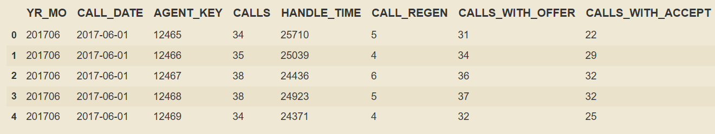
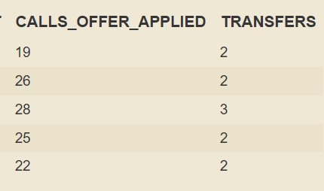

Collected Data

Slide 5
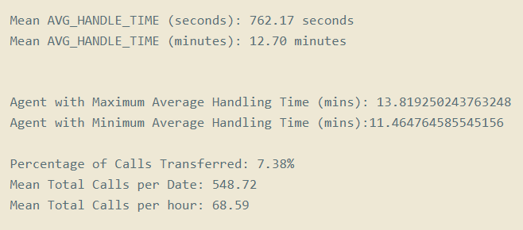
Collected Data

Slide 6
METHODOLOGY
Explore call center intricacies
Data Utilization:Employ a comprehensive dataset for empirical foundations.
Implement Monte Carlo method.
Monte Carlo Exponential Distribution: Utilize the exponential distribution to model randomness.
Queuing Dynamics: Address challenges when agents are occupied Introduce a queuing mechanism for caller

Slide 7
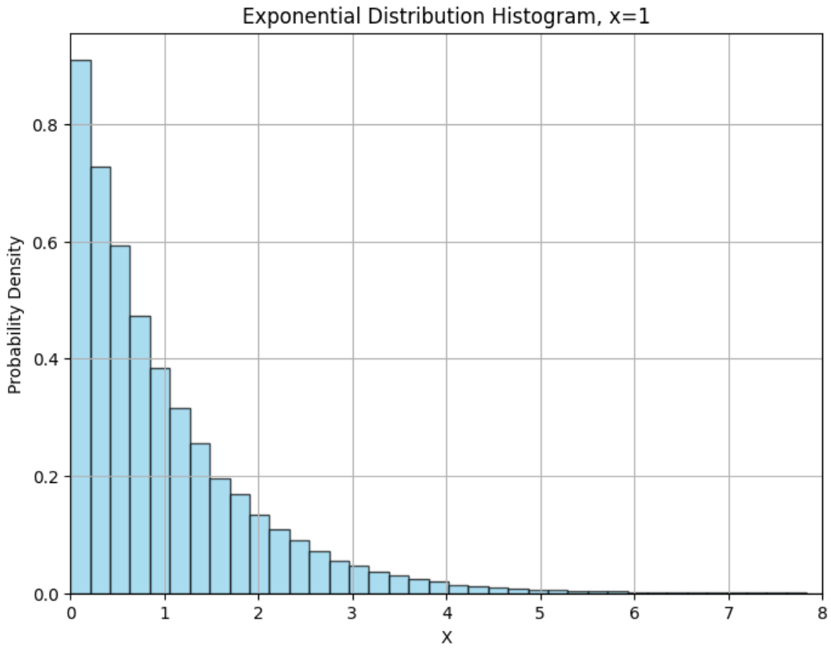
METHODOLOGY

Slide 8
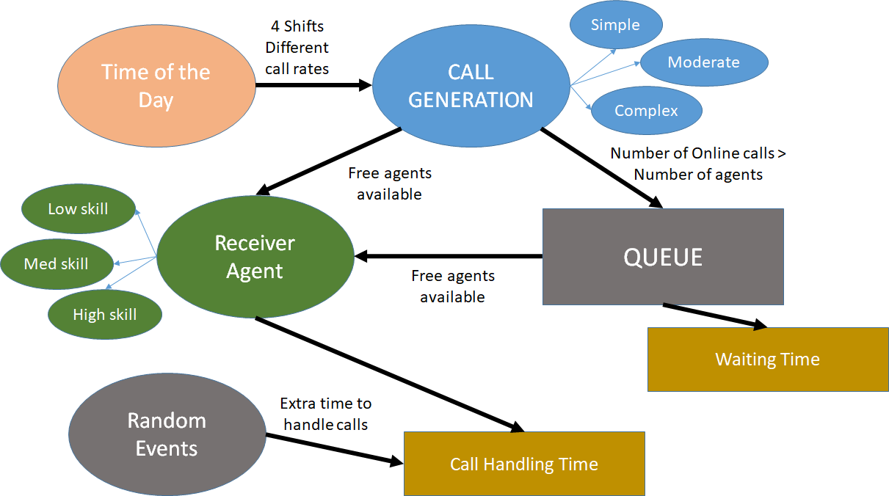
METHODOLOGY

Slide 9
METHODOLOGY
Key Performance Indicators:
Waiting time
Queue length
Scenario-based Simulations:
Various agent skill distribution
Highly probable complex call rate
Highly probable random events
Random Forest Algorithm
Feature impact evaluation

Slide 10

METHODOLOGY
Simulation environment:
Python - Simpy
Ideal Environment for DES
(Discrete event simulation)

Slide 11
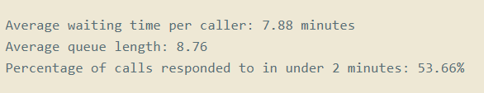
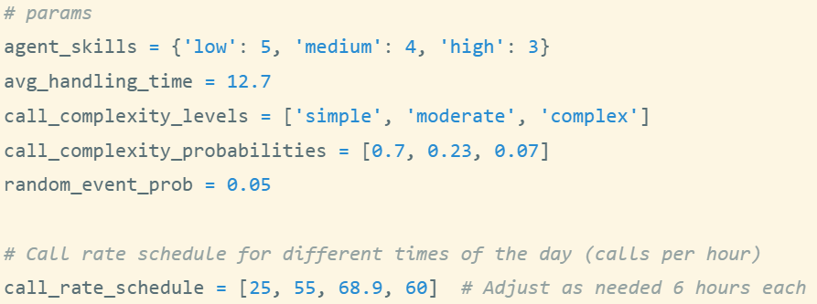
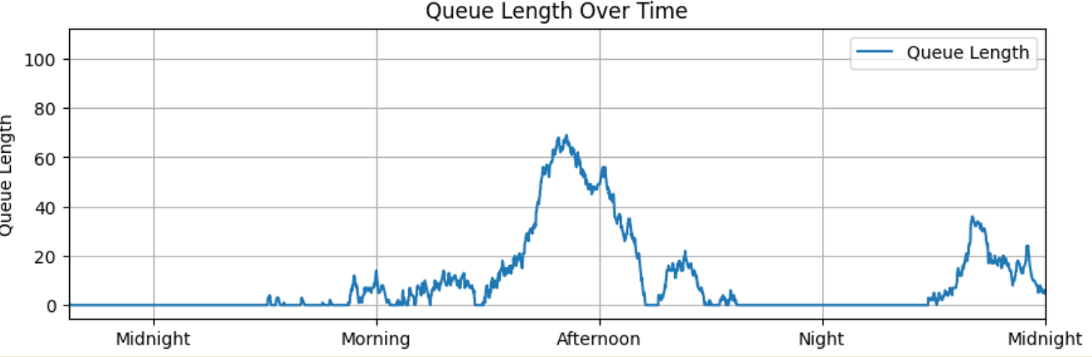
Result Analysis :
Queue length across different times of the day

Slide 12
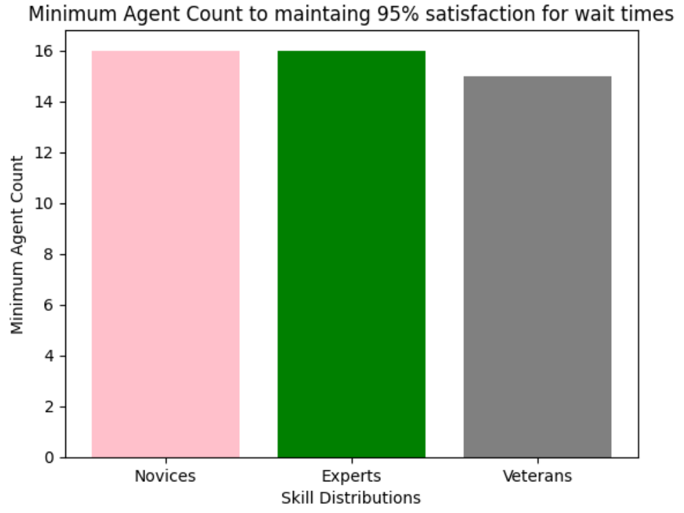
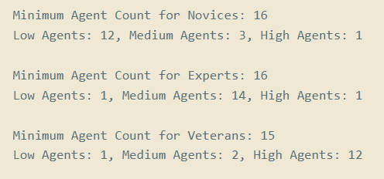
Result Analysis:
Agent Skill Variation Impact Analysis

Slide 13
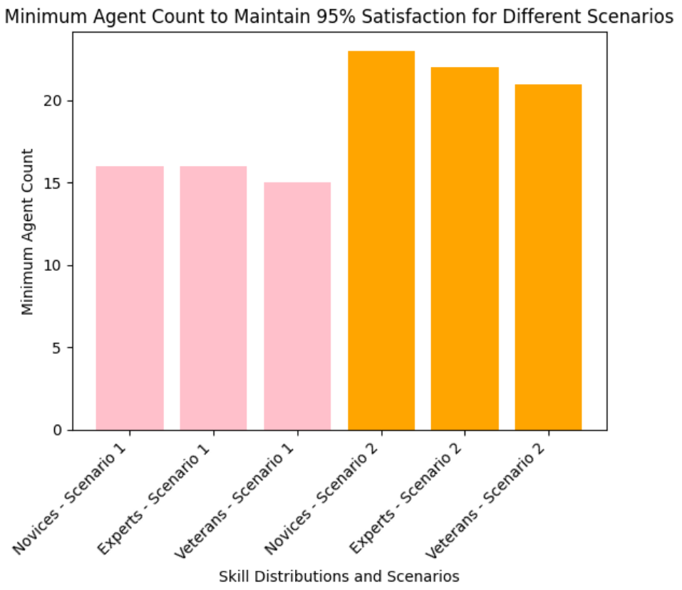
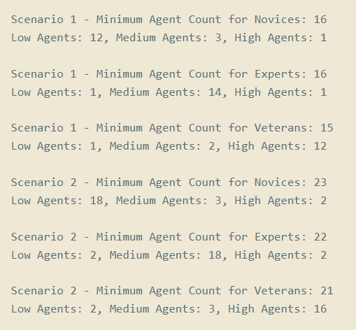
Result Analysis:
Impact of Increased Probability of Complex Calls

Slide 14
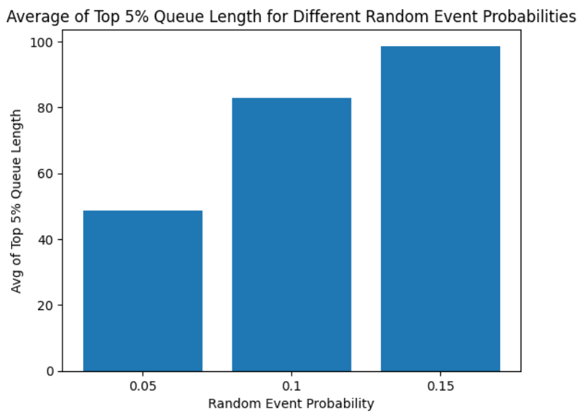
Result Analysis:
Impact of Varying Probability of Random Events

Slide 15
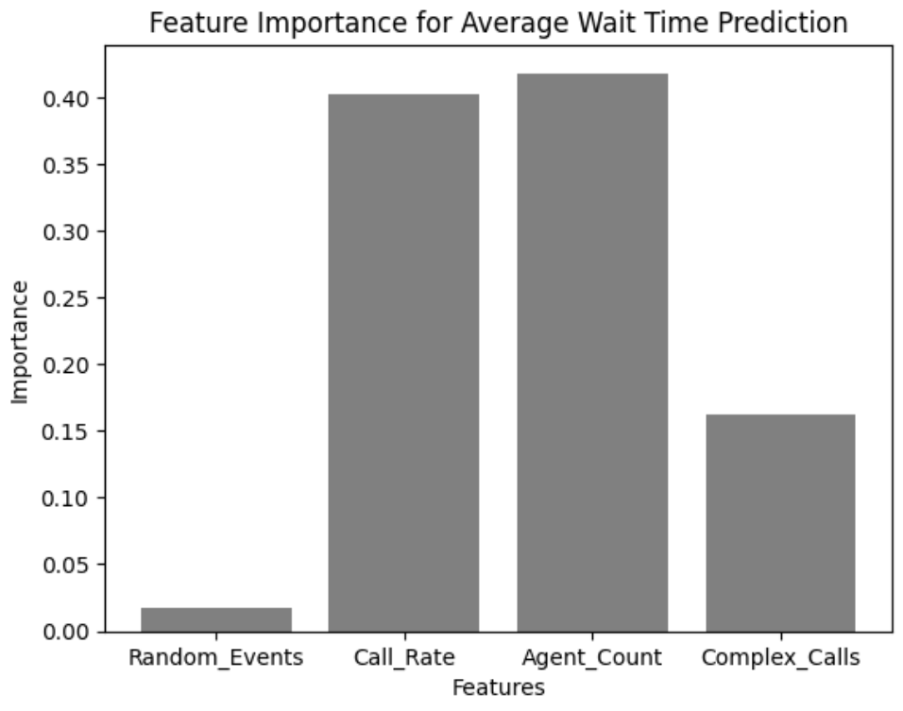
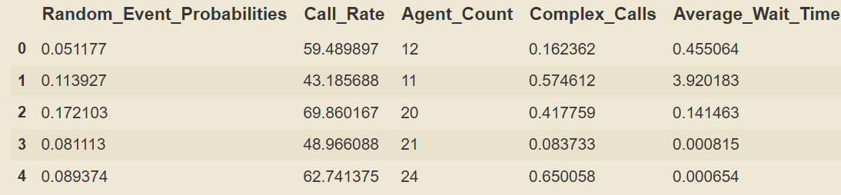
Result Analysis:
Random Forest Analysis
Dataset
Feature importance

Slide 16
Limitations
Absence of Breaks
Uniform Agent Efficiency
No Call Drop Concept
Unlimited Caller Wait Time
Limited Exploration of Random Events

Slide 17
Future work
Better Agent Availability model design
Random Event penalty modification
Using large volume of data, training and deploying a random forest model

Slide 18
Conclusion
Leveraging the potential of DES
Gaining a profound understanding of daily and real-time control actions is challenging for modelers, highlighting the importance of comprehensive operational insights.
Realistic call center models require access to high-quality, detailed data, emphasizing its crucial role in the development process.
The application of Monte Carlo simulation, complemented by Random Forest modeling, provides valuable insights into complex operational dynamics, contributing to enhanced key performance indicators, operational efficiency, and customer satisfaction.

Slide 19
Thank You

